Slide 1
INTRODUCTION
The reason
This is where you can describe the reason why you as a company have started your search and project for a Meeting Management System.
E.g., Company is in a digital transformation where we need to move to cloud-based services, because of the high level of security and low maintenance. In this transformation, we are looking into all our services and programs in Company, and we can conclude that we have a lot of legacy services that will never be able to follow the quick development of tech.
Furthermore, over the years we have implemented a lot of programs and services from a lot of different vendors that are stand-alone services that do not work together. This results in very manual processes all around in the company. This can be done easier and more efficiently if we can consolidate some of these services and processes into the same vendor. The services of areas which we can consolidate is within in the Kitchen, Service Providers, Reception, Facility Services, Front Desk, Finance, IT, etc.. By consolidating these areas we can make sure that all services work and talk together. This will make so many processes in the company so much easier and will be better to maintain.
The AskCody Platform consists of many different modules that all influence different departments and segments in your company. One, and maybe the most important part of the Platform is the Add-ins for Outlook. Add-ins are small programs integrated directly into your Outlook, like apps, that will help you make your meeting booking process easier and more efficient.
What can AskCody do for you?
With the Add-ins available directly inside your Outlook, you will be able to:
Find the best suitable room for your meeting
Request catering and services
Add external visitors to the reception
… within 2 minutes!
You don’t believe us? Watch this 2 min. video.
The best part of it, is, if you need to change the time or date of the meeting, you simply open your meeting invitation in Outlook and change the time, and then EVERYTHING will follow and update automatically -without you doing anything.
So, what can AskCody do for you? It can remove friction, hassle and save you time when you book meetings and everything according to meetings.
What is AskCody
AskCody is a meeting management and resource scheduling Platform that drive meeting efficiency through advanced meeting room booking, meeting catering and services, visitor- and front desk management, workplace statistics and insights, helping organizations and employees manage meetings smarter.

Slide 2
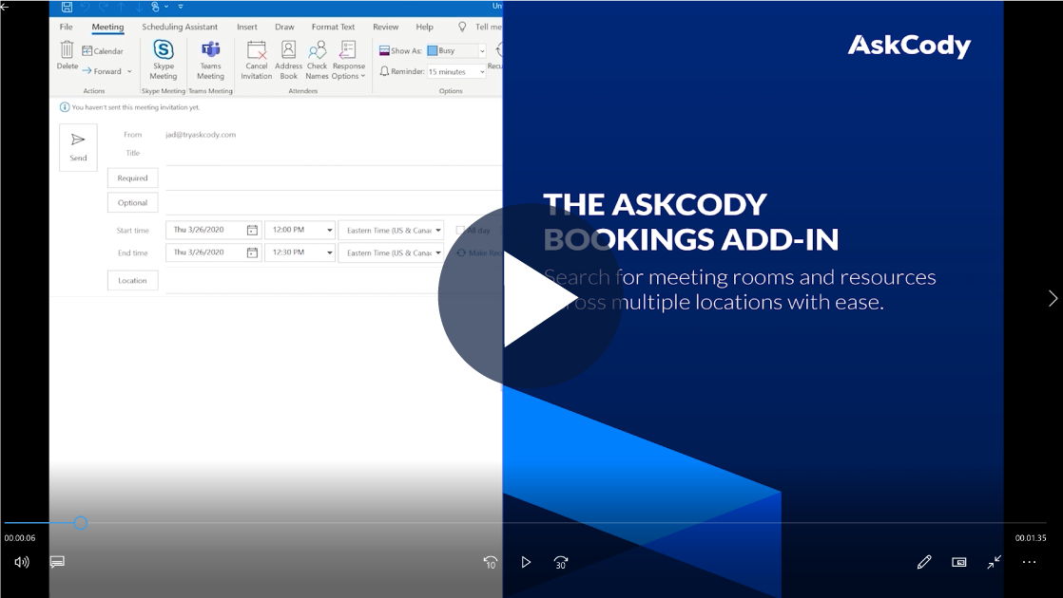
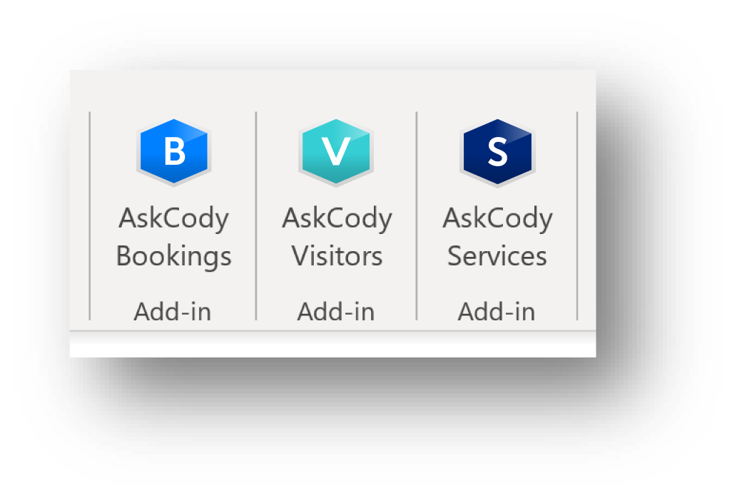
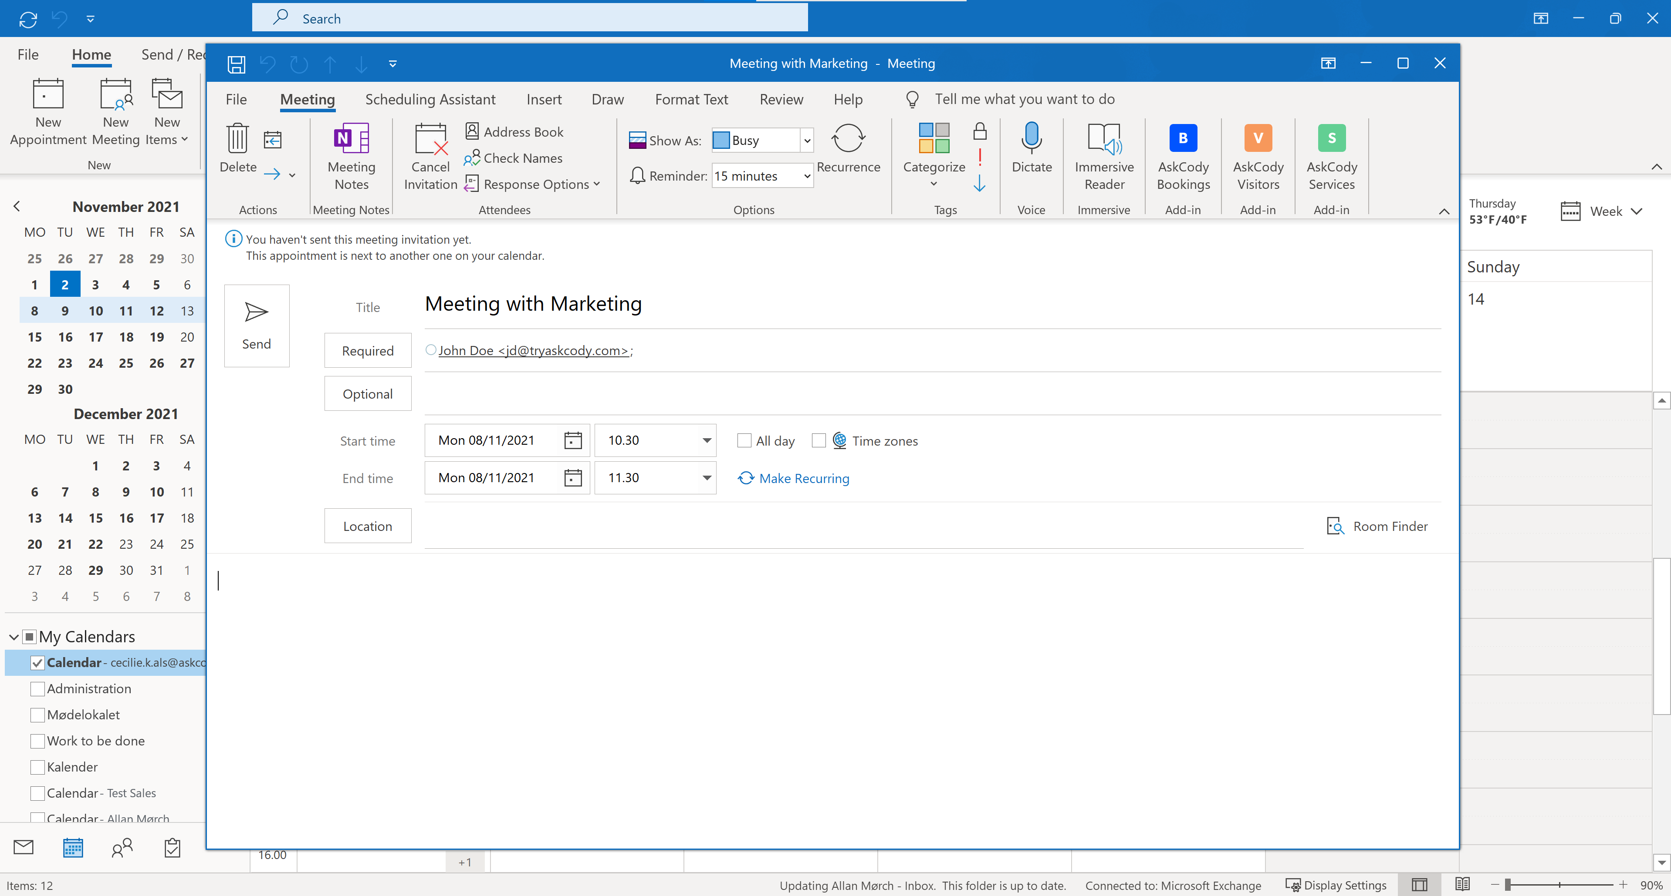
HOW TO USE BOOKINGS IN OUTLOOK
What is AskCody Bookings?
The bookings Add-in is built to filter your search for a meeting room or desk, based on location, purpose, equipment, and the actual number of attendees, so you only get presented the best suitable options that match the purpose of your meeting. This will help the company to get better utilization of all our meeting rooms and our workplace and ensure a grate booking behavior among the meeting bookers, so no rooms with facilities and equipment are booked if there is no need for it. The Bookings Add-in combined with the two other AskCody Add-ins, Services and Visitors; you can handle everything according to meetings directly inside your Outlook.
How to book with AskCody Bookings?
Create a new Outlook meeting invitation Everything happens in Outlook, so create a meeting invitation as you normally would do.
Fill out meeting information Name, Attendees, Time and Date. You will use the Bookings Add-in to find your room or desk.
Open the Bookings Add-in At the top of your Outlook ribbon, you have your 3 new AskCody Add-ins, start by opening Bookings. - Look at the picture to the right.
More steps on next page

Slide 3
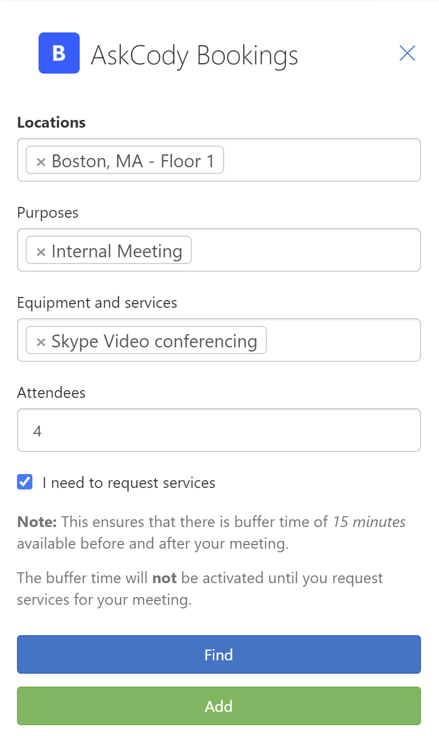
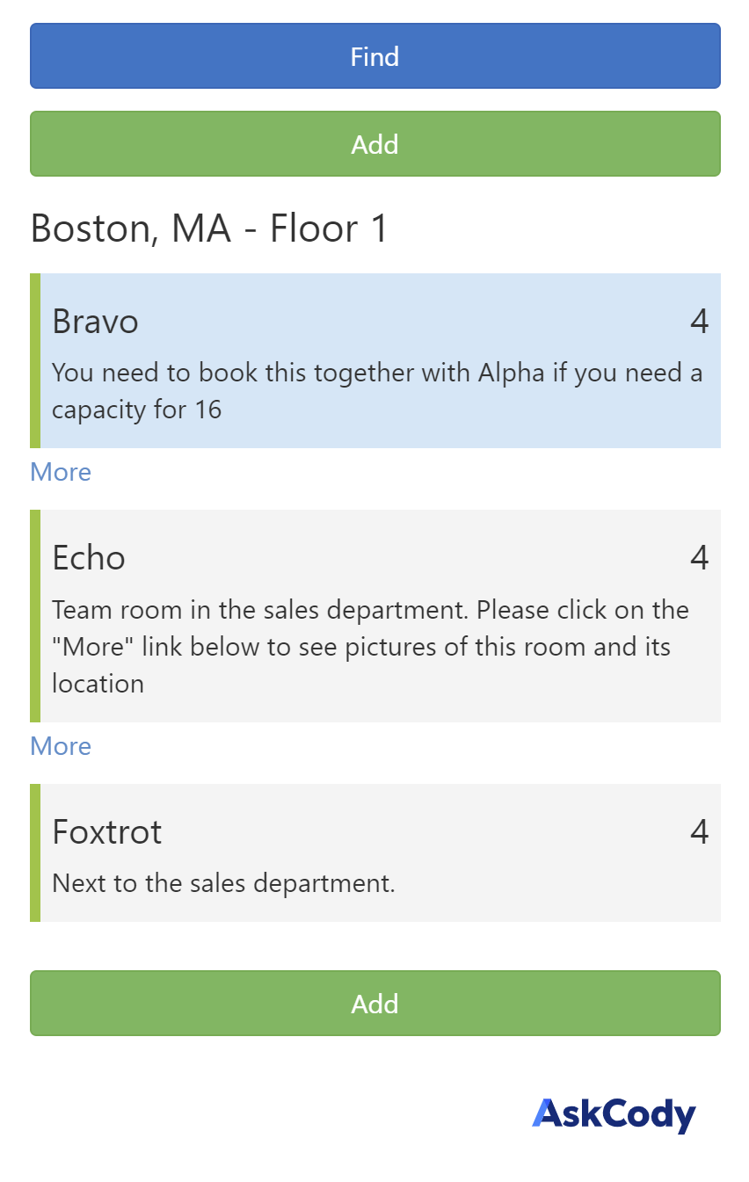
Select one or more locations You can choose to book a room or desk in all the locations in the company. Your location can be named by City, Office or floor and differs from location to location. You can choose to search for rooms and desks across multiple locations if your meeting involves attendees attending from different offices -you can book a room for them.
Choose your purpose for the meeting All our rooms are marked with a meeting purpose (Internal meetings, External meetings, Desk, etc.). This is so you quickly can identify which rooms best fit your needs. You can choose as many purposes as you want, but note, if you choose more than one purpose, you will search for rooms that have both purposes attached to it, and not all rooms in the category of the two purposes.
Select Equipment and Services Do you have any requirements for your meeting, like Video Conference equipment, whiteboard, projector, etc.? Choosing Equipment and Services for your meeting will help you narrow down your room search.
Attendees The number of attendees already showing in this field is a sum of all attendees added to your meeting + yourself. Typically, you don’t need to change this number unless you know that not all attendees will be psychical present at your meeting. This number is key to finding a room with enough capacity for you and your attendees.
(Checkbox) I need to request services Check this box if you need to order services and catering for your meeting. As mentioned in the text, this will add a buffer time of 15 min. both before and after your meeting. This buffer time is for preparing and cleaning the room for the service staff.
Click “Find” You have now narrowed down your search for finding the perfect room or desk for your meeting, click “Find” to see your results.
More steps on next page

Slide 4
Choose one or more rooms When you have clicked “Find” your search results for rooms and desks will show. If you have chosen more than one location your results will be divided into each location. The best-fitting room/desk, that matches your requirements, will be represented at the top. This should be the room/desk you choose. In each room or desk represented, you will see the name, capacity, and description. Some of the rooms/desks have a “More” link attached, this is a link with a floorplan and a picture of your room/desk.
Click “Add” When you have chosen the room(s) or desk you need, click the “Add” button to add them to your meeting invitation. The room will now appear in the location field in your meeting invitation. **Remember to send your meeting invitation in Outlook after adding room/desk from the Bookings Add-in**
Internal Rules
You are only allowed to book External rooms if you have external attendees attending psychical in your meeting.
You should only book desks in the area of your own department.

Slide 5
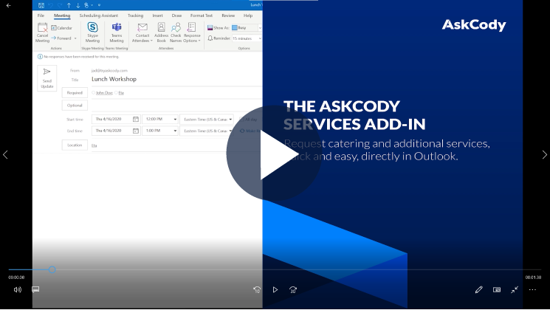
HOW TO USE SERVICES IN OUTLOOK
What is AskCody Services?
With Services you can quick and easily request catering, refreshments, table arrangements, or AV setups directly in your familiar interface of Outlook, on both your desktop, laptop, tablet, or phone. The corresponding parties (kitchen, provider, canteen management, AV provider, or facility management) are instantly notified of your requests and know exactly what, when, and where you need it because the AskCody Platform also provides a Service Management tool for the involved parties where they can manage everything from. And don’t worry, if you move your meeting, change the time, or need to update your request, everything will follow your meeting invitation automatically.
How to create a request with the AskCody Services?
Open your meeting invitation When you are ready to request service for your meeting, simply open your already created meeting invitation in Outlook.
Open the Services Add-in At the top of your Outlook ribbon, you have your new 3 AskCody Add-ins. To request services for your meeting , open Services. - Look at the picture to the right.
More steps on next page

Slide 6
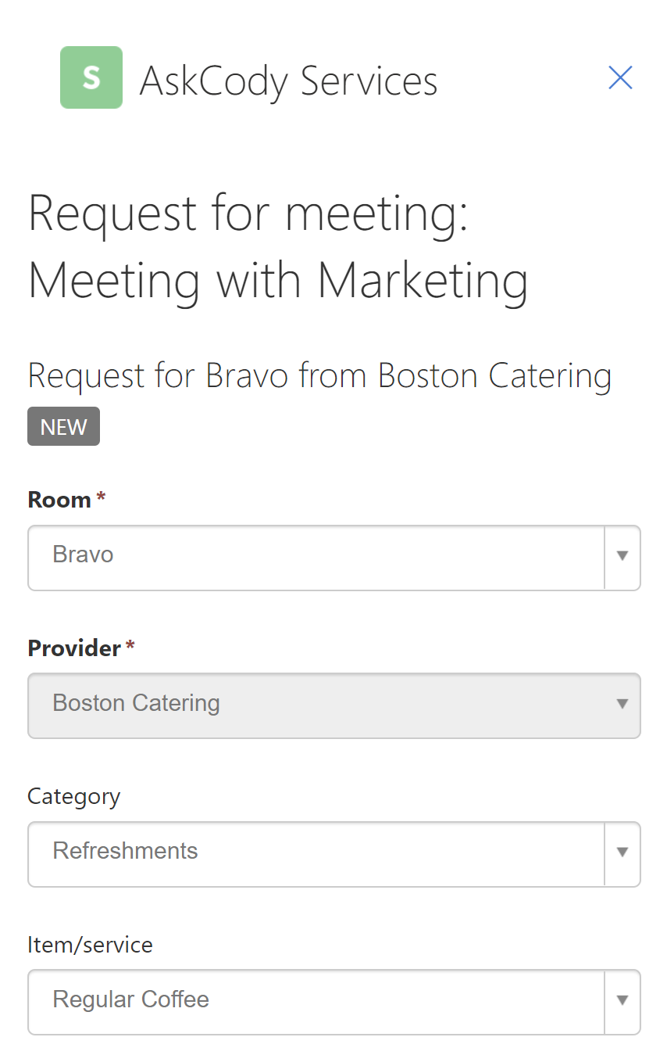
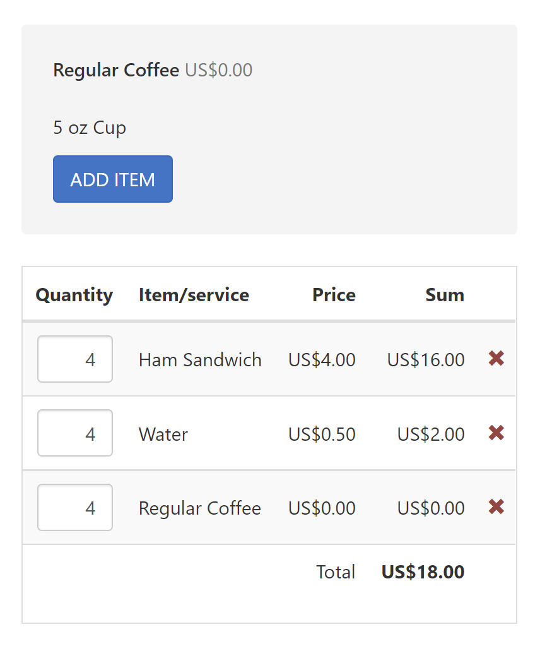
Choose room Normally you would only have booked one room for your meeting and in that case, the Room field will be locked. But if you have more than one room booked for your meeting, e.g., for an all-day workshop or across different locations, you must choose which room you want to request services for.
Select Provider Based on the room you have booked for your meeting; specific providers will be available to choose from. If there is only one provider that can deliver to your chosen meeting room, the field will be locked, if your have more options, please select a provider of your choice.
Choose a category of services Think of this request process like it was shopping on a webshop! First, you choose the webshop (Provider) you want to buy your service/item from. Then you choose in which category your service/item you want to buy belongs. And then, you find your item and add it to your basket.
Find your service or item You have now found in which category your item belongs to, now choose the item you wish to add to your item list in the field “Item/Service”
Add your item to the item list (basket) You have found your item, now you just need to add the item to your basket or item list. Click on the “Add Item” button. You will now see your item as a line in the request overview.
Change quantity When you click on “Add item” there will automatically be added 1 item to your list. Simply click the “Add Item” button multiple times to change your amount or click in the quantity field directly.
<<<<
More steps on next page

Slide 7
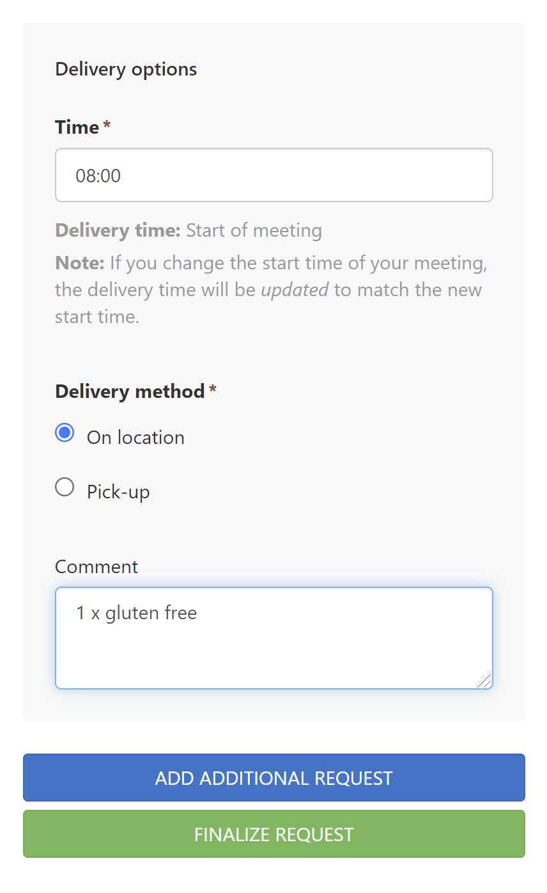
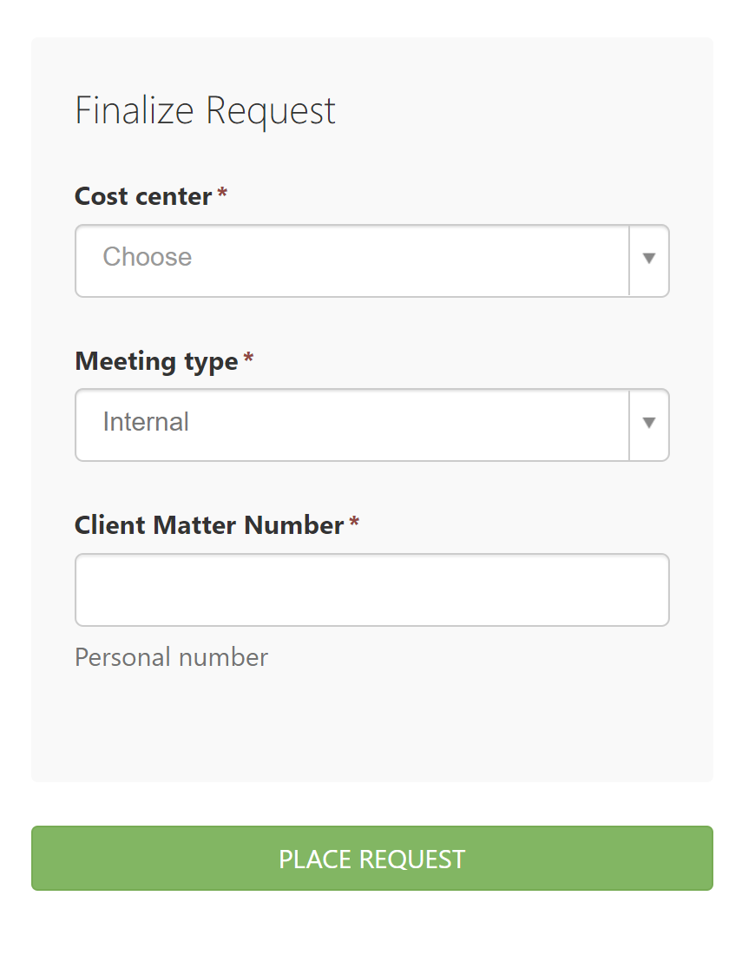
Time of delivery The preselected time of delivery will always be at the start of the meeting. You can select a different delivery time within the time slot of your meeting. Choosing the start time of the meeting, your request will follow your meeting automatically if you move the meeting. If you choose an alternative delivery time, your request will be detached from the meeting until you choose a new delivery time on your request.
Delivery method Depending on the provider you have chosen, you can have the option to choose if you want your request delivered to the location of your meeting room or if you want to pick it up at the provider. These options can vary from provider to provider.
Comment Anything worth mentioning to the provider, you have the option to write a comment on your request.
More than one request for your meeting? Click on “Add additional request” if you e.g., need breakfast delivered at the start of your meeting, but you want lunch delivered later in the meeting. Then create an additional request with lunch and a new delivery time for that request.
Finalize your request When you have created the requests you need for your meeting, click the button “Finalize request”. This will unfold the last bit of information needed before adding a request at the provider. These are entirely for tax regulations. Cost center is the account that will be charged for the request. You can have access to one or more cost centers. Meeting type is required because of tax regulations to inform if it is an Internal- or an external meeting with external attendees. Client Matter Number is your personal request number, you use every time you buy anything in Company related situations.
More steps on next page

Slide 8
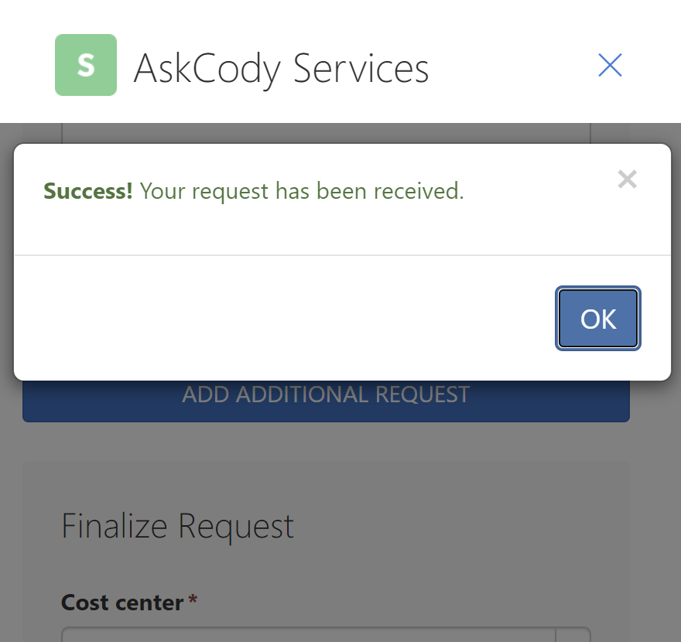
Place request When clicking on the button “Place request” it will send your request(s) to the provider. The provider will make sure you will have your request on time and in the place you have chosen. When your request is sent correctly, it will pop up a green Success information (See picture) and you will receive a confirmation email. Your request will now be pending until your request is accepted by the provider. If the request does not show the Success information, it might be because you miss filling out some information in your request. These will now be highlighted with red in your request, so they are easy to find. If you have no further additions, simply close your meeting invitation. You don’t have to send the meeting invitation again.
Internal Rules
The provider deadline is the day before 12 pm (noon). Meaning that you must request services for your meeting the day before your meeting, at 12 pm.
If you try to add a request to your meeting after the provider deadline, the Services Add-I will be unavailable.
If you have requested services for a meeting in the future, but move your meeting within the provider deadline, your request will be rejected og not delivered. Simply move your meeting outside the provider deadline again and the Services Add-in will send your request update to the provider. You will also receive confirmation emails with instructions on what happened and what to do.
More steps on next page

Slide 9
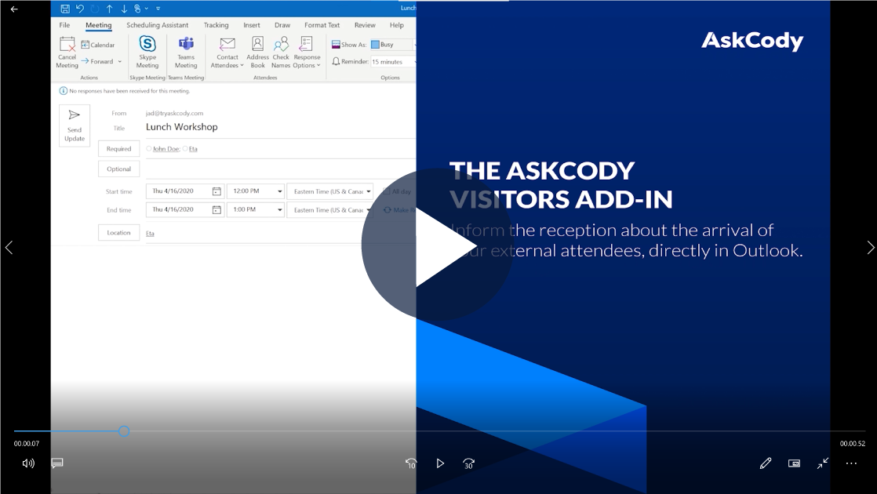
HOW TO USE VISITORS IN OUTLOOK
What is AskCody Visitors?
With Visitors, you can quick and easly inform the front desk or reception about the arrival of your external attendees for your meeting. Give your attendees the best visitor experience with the Visitor Management system from AskCody. The system provides emails and SMSs to your attendees before they arrive with directions to where to park, meeting information, and what to do when they arrive. The receptionists are prepared because you added your visitors to the reception via the Visitors Add-in directly from Outlook. The receptionists will either check-in your visitors or your visitors can check in themselves. Immidiatly after check-in, you or the host of the meeting receives an email or an SMS with a notification about your visitor has arrived.
How to add a visitor to the reception?
Open your meeting invitation If you have requested services for your meeting with the Services Add-in, your meeting invitation is already open! If not, open your meeting invitation.
Open the AskCody Visitors Add-in At the top of your Outlook ribbon, you have your 3 AskCody Add-ins. To add visitors to the front desk or reception, open the AskCody Visitors Add-in. - Look at the picture to the right.
More steps on next page

Slide 10
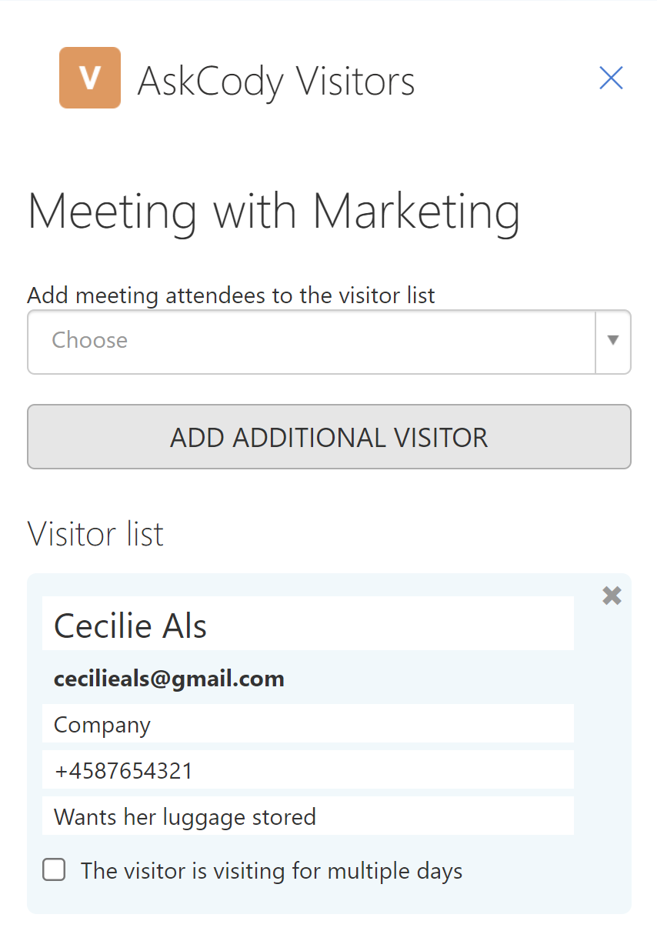
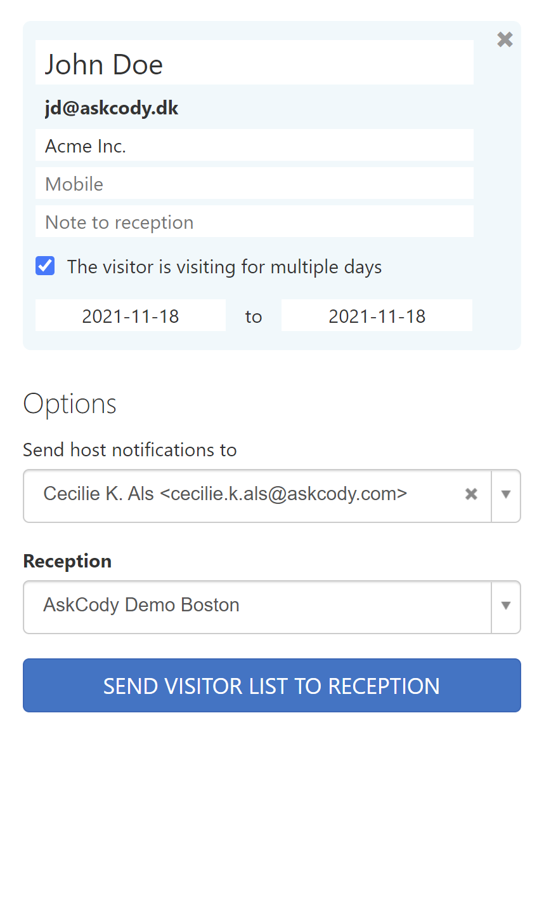
Add your external attendees to the visitor list Click on the dropdown “Add meeting attendees to the visitor list” and choose who you would like to add to the front desk/reception. When you click on an attendee in the list a blue card with information will appear in the visitor list.
(Optional) Click the button Add Additional Visitor Sometimes it is necessary to add a visitor to the front desk/reception that is not added in your meeting invitation. Simply click on the button “Add Additional Visitor”.
Fill in information on the visitor cards Your visitor list consists of one visitor card for each of the attendees you chose in the dropdown list. Once the information on a visitor card is filled out the AskCody Visitors Add-in will save the information for later use. So, if you or others in your company are adding this visitor to your front desk/reception in the future, all information fields will be prefilled on this visitor. The visitor card information: Name of the attendee. Most of the time this information is prefilled by the Add-in. Email address of your visitor. This is not editable. Company. Type in the name of the company your visitor is from. Mobile phone number of your visitor. This is important to fill out if your visitor should receive SMSs about arrival, parking, check-in, and important information about your company. Note to reception, if there is something special you need to notify the front desk/reception about your visitor. Checkbox “The visitor is visiting for multiple days”. Sometimes you will have a visitor coming to the office for more than one day. Tick this checkbox and fill in the arrival- and leave days. This will notify the reception and prepare a multiday visitor badge.
<
More steps on next page

Slide 11
Send host notifications to You are automatically set as the host of the meeting because you are organizing the meeting, and normally you receive the notifications when the visitors arrive. But if you are scheduling a meeting on behalf of someone else, it is possible to choose this person to receive the notifications. Or if you are sick on the day of the meeting, you can choose your colleague to receive the notifications about the visitor's arrival.
Choose reception If you have chosen more than one meeting room for your meeting –maybe you have a workshop and the meeting rooms do not have the same reception attached, you can choose which reception you want your visitors to arrive at.
Send visitor list to front desk/reception When you are ready and have filled out the necessary information on your visitor cards, you press the button “Send visitor list to reception”. Once the visitor list is sent to the front desk/reception, a small Success box will pop up. You can now simply close your meeting invite, no need for sending the meeting invite in Outlook again.
Internal Rules
Your colleagues at other locations are External Internals, meaning they will be treated as if they were External visitors. You should therefore add them as visitors to the front desk/reception.
Do you have more than 10 persons to add to the front desk/reception, you can choose to send an Excel sheet with the visitor information and send it to the front/reception. Then, they will create your visitors as a group in their AskCody Visitors system. You should always use the excel file in this article and send it to the front desk/reception email. If you need help, watch this video.

