Slide 1
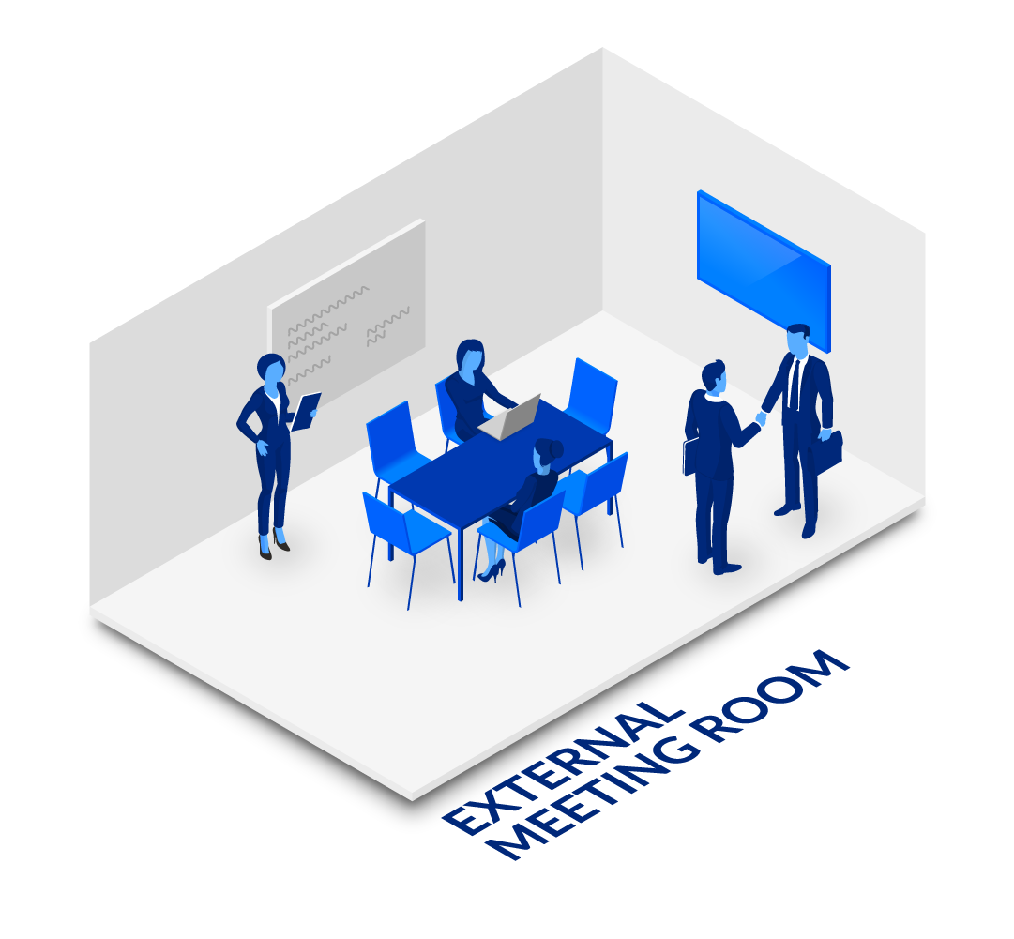
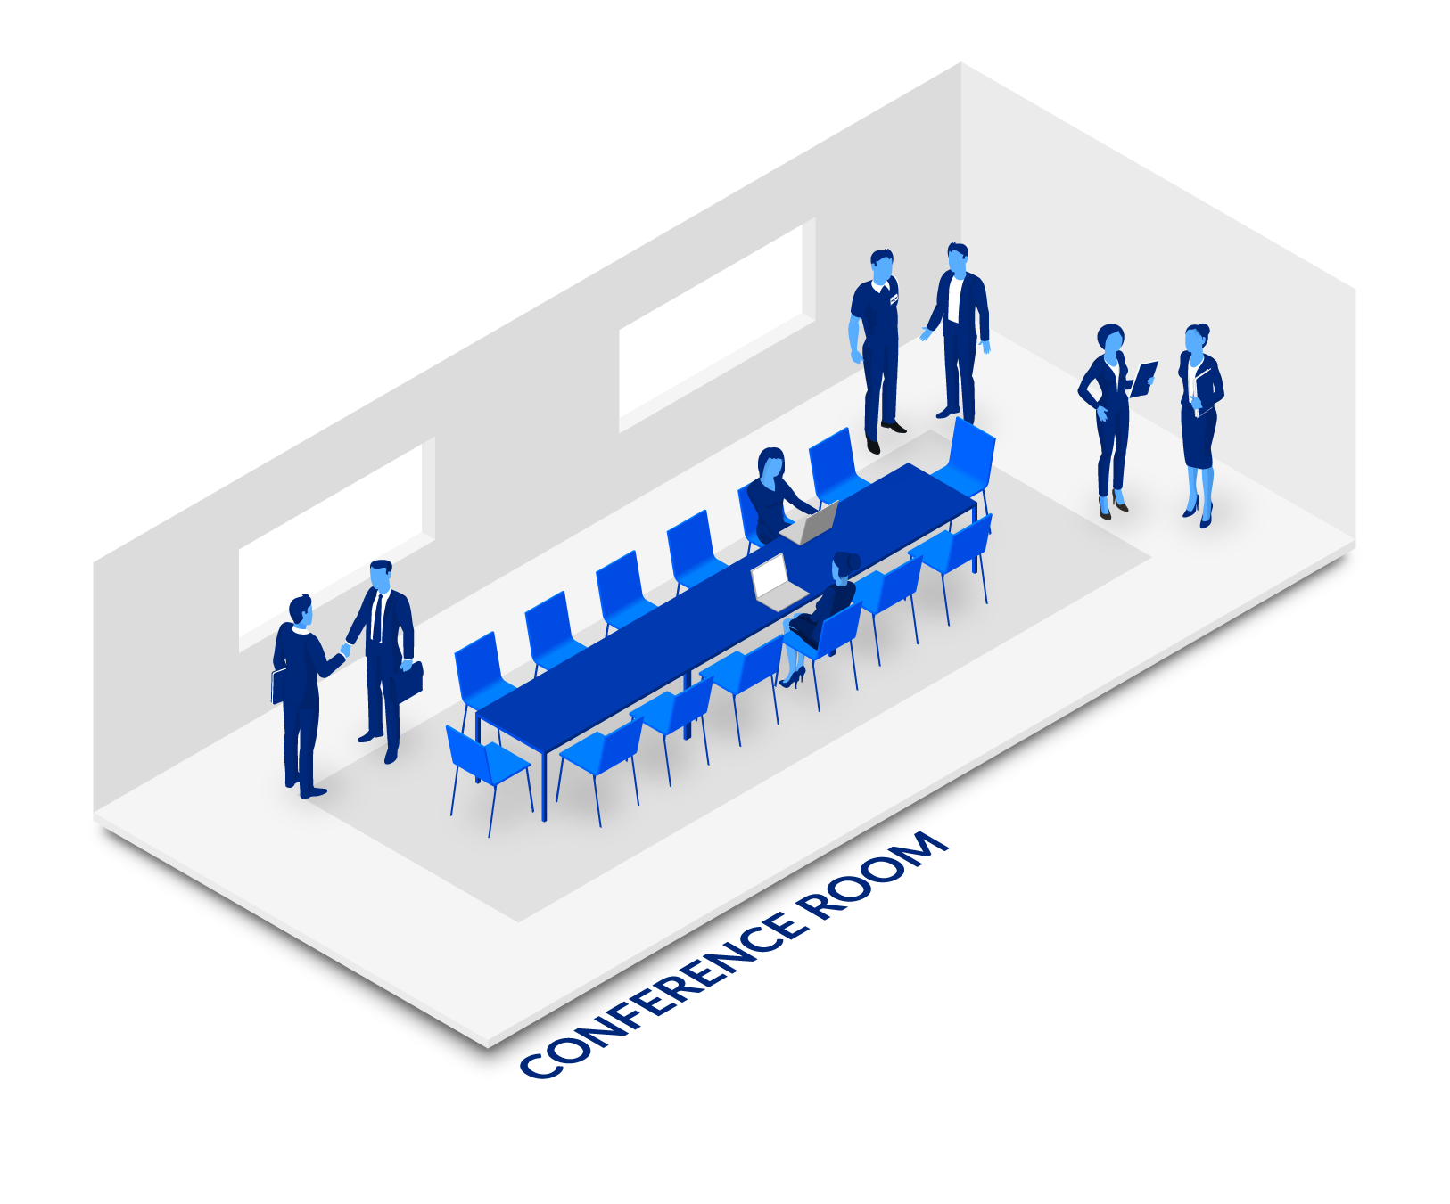
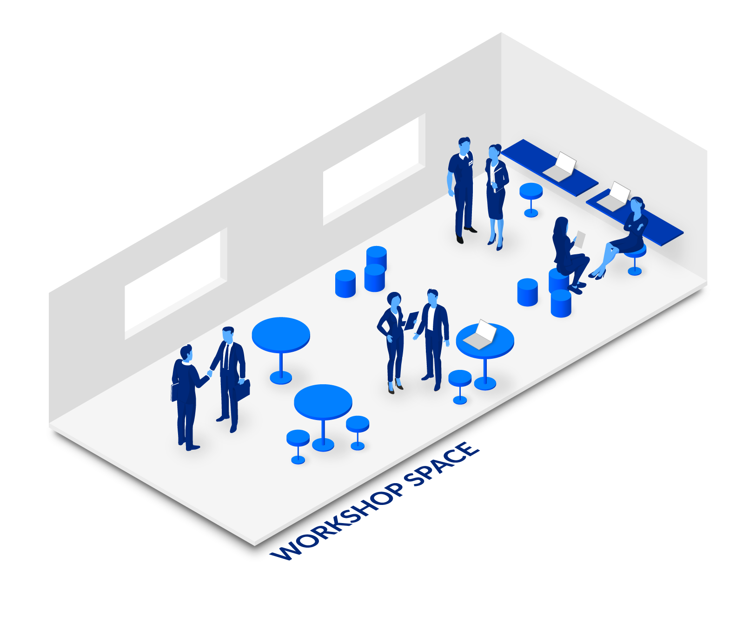
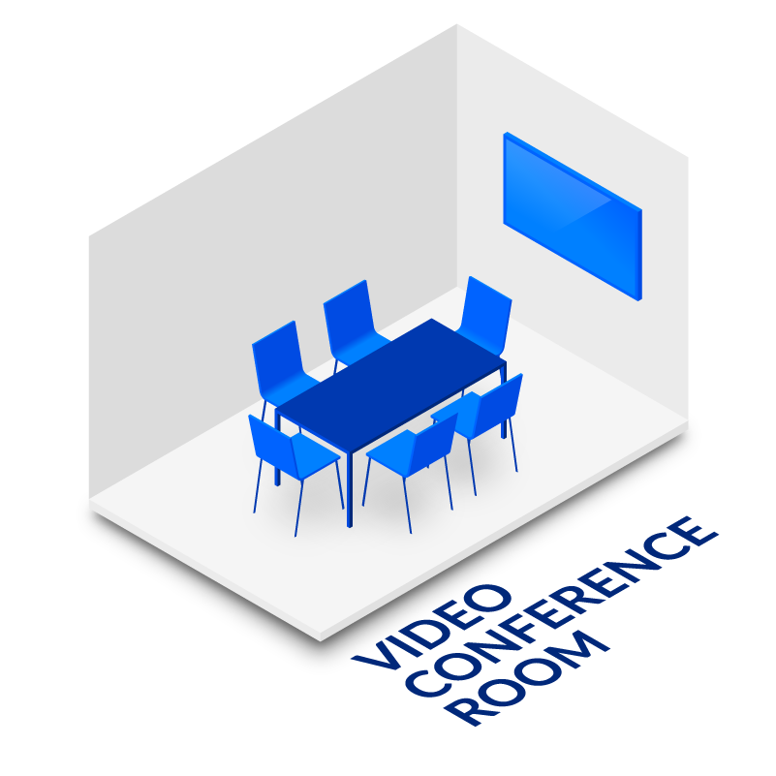
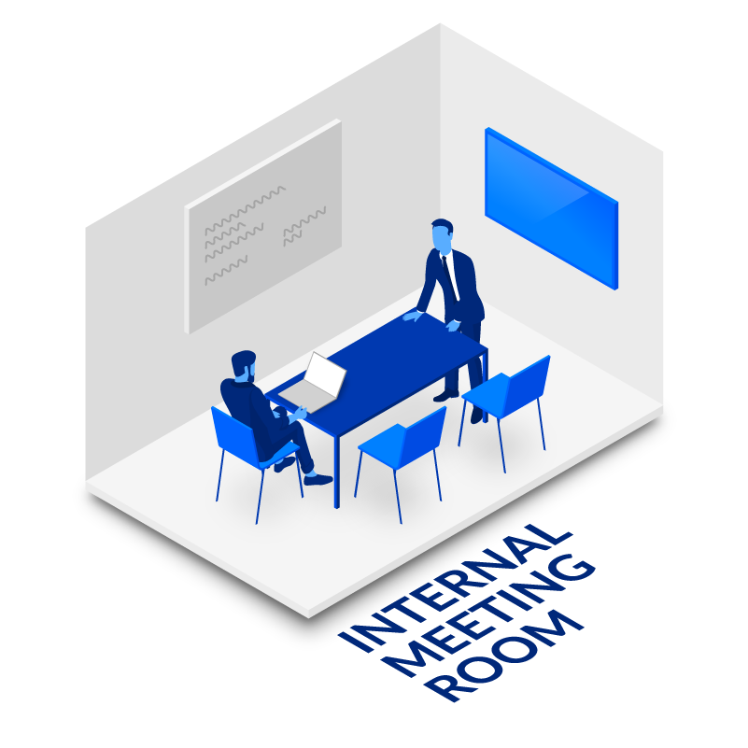
Smaller Rooms and spaces
ROOM TYPES
A meeting room is not just a meeting room: Welcome to the agile workplace
Medium-sized rooms
Larger rooms and spaces
Regular Desk/Workspace (1)
Regular, bookable desk with fixed monitors
Circular touch down desks (1)
A different type of work setting for those not needing a fixed desk or 2x fixed monitors, and a great way to break up the linear space
Phone booth/Video booth (1)
High back private sofas and chairs (1-2)
Private space; an option to focus time away from the desk for a more relaxed work style or a quick call.
Enclosing's/Focus space (1-2)
Meeting Room (1-4)
Standard/default room
Internal Meeting Room (1-4)
For internal/private meetings, not exposed to guests and visitors
Video Meeting Room (1-4)
For small video meetings with video meeting tech
Focus room/Quiet room (1-4)
A meeting room to focused work or to shield yourself from distraction
A room which is secluded and allows for an employee to concentrate in a quiet environment. This is typically set up to accommodate one person at a time and has high quality sound and light isolation.
Huddle room/huddle zone/huddle space (1-4)
A room for smaller groups that does not need to be booked in advance but is instead used dynamically. These meeting rooms typically accommodate up to five people and typically feature a set of multi-media audio-visual system and/or a white board.
External meeting room (5-10)
Medium sized meeting room for external guests, clients, and visitors, often located close to the reception, lobby or show room
Video Conference room (5-10)
For larger video conferences with video meeting tech
C-level room (5-10)
A room only meant for meeting among c-level attendees, such as chief executive officer, chief operations officer, and chief financial officer. Often placed privately and not exposed to others in the organization
Group study room (5-10)
A room for group work and collaboration among teammates. These rooms typically have one seating arrangement for up to six people but do not necessarily contain video or audio equipment.
Workshop space/Collaborative working (+10)
Various settings of high and low tables to support ad-hoc meetings and break-aways from the desk to quickly pitch and share ideas. Includes bar chairs and tables, writable walls.
A larger room which has space for facilitating collaboration or idea sharing in larger groups. Workshop rooms usually contain a variety of tools to facilitate communication, brainstorming, arranging focus group workshops, roleplaying, and expressing ideas. The tools can be anything from flip boards, sticky notes, and markers to building blocks.
Conference room (+10)
A room for larger singular events or board meetings involving a large number of attendees. These rooms typically have one seating arrangement for up to twenty people (or more) but do not necessarily contain video or audio equipment.
Lecture room (+10)
A room for teaching groups of people or giving presentations. These rooms have multiple seating arrangements oriented towards the front of the room where the lecturer is positioned to be.
Auditorium (+10)
Same as Lecture Room, but with a fixed seating.

Slide 2
INCLUDING AND ENGAGING MEETING
MEETING PURPOSES AND TYPES
NO MEETINGS ARE CREATED EQUALLY:
WHAT IS THE PURPOSE FOR YOUR MEETING?
FORMAL MEETING
Intense meeting
Team Cadence
Weekly Team Meeting
Daily Huddle
Stand-up
Working Sessions
Idea Generation
Solution brainstorm
Campaign Ideas
Requirement Brainstorm
Progress Check
Project Status Update
Portfolio Review
Stakeholder update
Planning
Project Planning
Product Development Planning
Campaign Planning
Event Planning
One-to-one
Manager one-to-one
Coaching Session
Mentoring Session
“Catching Up”
Workshops
Design Workshop
Team Building
Value Stream Mapping
Kick-offs
Community of Practice
Meetups
Lunch-n-learn
Committee meetings
Action Reviews
Retrospectives
Win/loss review
Rehearsals
Governance Cadence
Board Meetings
Strategy reviews and refresh
Client QBR/EBR
Training
Skills Certifications
New-hire training and onboarding
Client Training
Broadcasts
All-hands meetings
State of the union
Webinars
Press briefing
Problem Solving
Root Cause Resolution
Incident Response
Plan Reset
Decision Making
Strategic Opportunity Decision
Candidate Selection
Final Approvals
Introductions
Sales Calls
First Interviews
New Candidate Introduction
Investor Pitch
Issue Resolution
Support Escalation
Contract Negotiation
Dispute Resolution

Slide 3
WHICH PURPOSE FITS THE RIGHT TYPE OF ROOM?
ROOMS AND MEETING PURPOSES

